Slide 1
Bias/Variance Trade-off,
Regularization and the curse of dimensionality
"Some of the figures in this presentation are taken from "An Introduction to Statistical Learning, with applications in R" (Springer, 2013) with permission from the authors: G. James, D. Witten, T. Hastie and R. Tibshirani "

Slide 2
Announcements
Exam 2 review
Wednesday 3/4/2019
Online
Exam 2
Wednesday, 10/4/2019 13:00-15:00
Multiple-choice
Bonus Marks opportunity:
Monday 8/4/17
Ethical issues around AI and IT debate
The ability to articulate abstract thoughts is one of the most important skills for your professional life
Like most skills, you need to practice it, in order to polish it

Slide 3
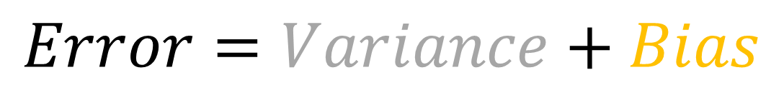
The error of any machine learning model is composed of 2 parts
$$Error=Variance+Bias$$

Slide 4
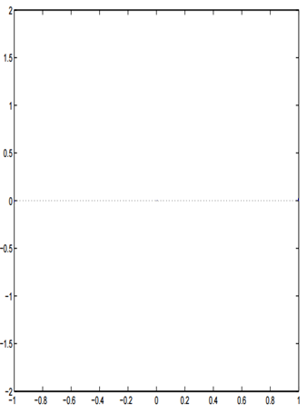
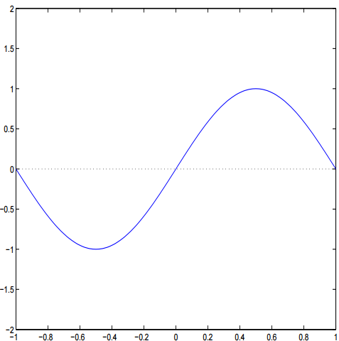
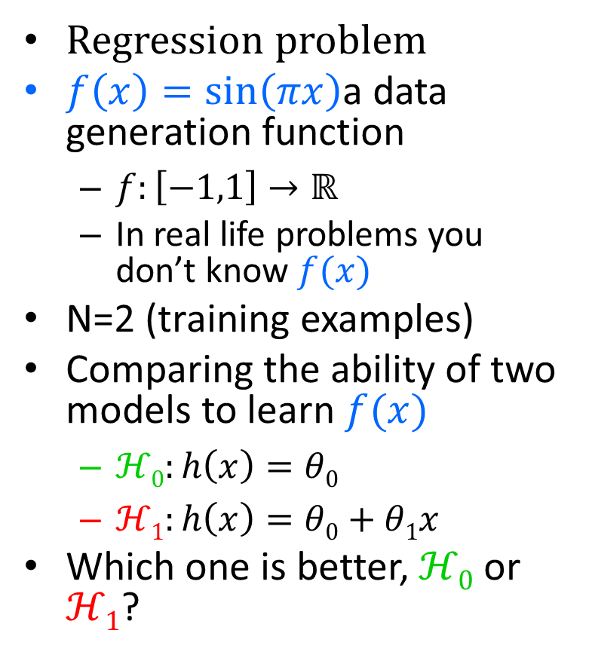
Bias and Variance: A tentative visualization
Regression problem
$f\left(x\right)=\sin\left(πx\right)$a data generation function
$f:\left[−1,1\right]→ℝ$
In real life problems you don’t know$f(x)$
N=2 (training examples)
Comparing the ability of two models to learn $f(x)$
$ℋ0:h\left(x\right)=θ0$
$ℋ1:h\left(x\right)=θ0+θ1x$
Which one is better, $ℋ0$ or $ℋ1$?

Slide 5
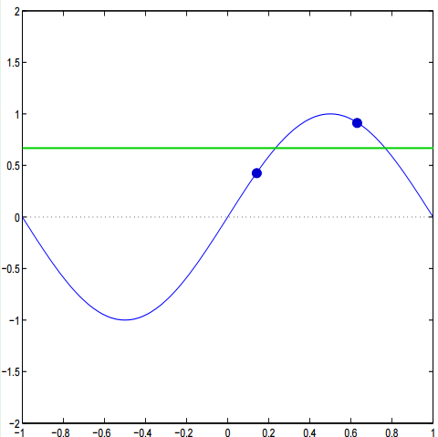
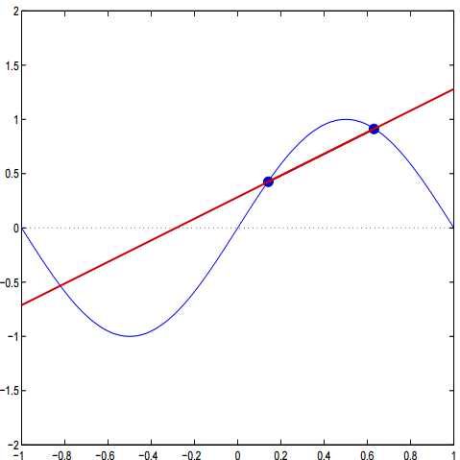

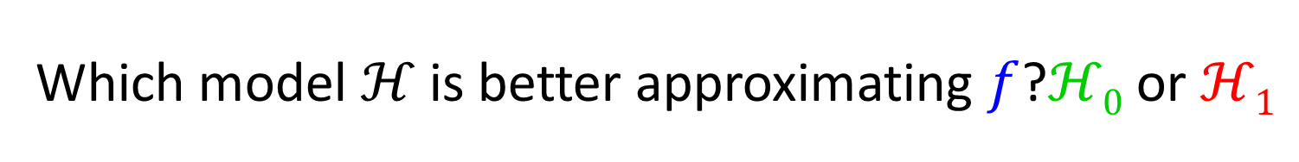



Which model $ℋ$is better approximating $f$?$ℋ0$ or $ℋ1$
$$𝓗0=θ0$$
$$𝓗1=θ0+θ1x$$
$$f=sin⁡(x)$$
$$f=sin⁡(x)$$

Slide 6

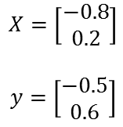

Illustration of Bias
$$𝓗0=θ0$$
$$𝓗1=θ0+θ1x$$
$$X=\left[\begin{matrix}−0.8 \\ 0.2\end{matrix}\right]$$
$$y=\left[\begin{matrix}−0.5 \\ 0.6\end{matrix}\right]$$

Slide 7

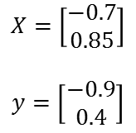

Illustration of Bias
$$𝓗0=θ0$$
$$𝓗1=θ0+θ1x$$
$$X=\left[\begin{matrix}−0.7 \\ 0.85\end{matrix}\right]$$
$$y=\left[\begin{matrix}−0.9 \\ 0.4\end{matrix}\right]$$

Slide 8

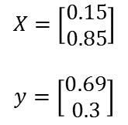
Illustration of Bias
$$𝓗0=θ0$$
$$𝓗1=θ0+θ1x$$
$$X=\left[\begin{matrix}0.15 \\ 0.85\end{matrix}\right]$$
$$y=\left[\begin{matrix}0.69 \\ 0.3\end{matrix}\right]$$

Slide 9
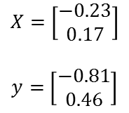
Illustration of Bias
$$𝓗0=θ0$$
$$𝓗1=θ0+θ1x$$
$$X=\left[\begin{matrix}−0.23 \\ 0.17\end{matrix}\right]$$
$$y=\left[\begin{matrix}−0.81 \\ 0.46\end{matrix}\right]$$

Slide 10
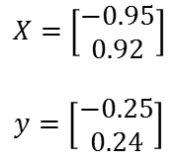
Illustration of Bias
$$𝓗0=θ0$$
$$𝓗1=θ0+θ1x$$
$$X=\left[\begin{matrix}−0.95 \\ 0.92\end{matrix}\right]$$
$$y=\left[\begin{matrix}−0.25 \\ 0.24\end{matrix}\right]$$

Slide 11
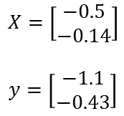
Illustration of Bias
$$𝓗0=θ0$$
$$𝓗1=θ0+θ1x$$
$$X=\left[\begin{matrix}−0.5 \\ −0.14\end{matrix}\right]$$
$$y=\left[\begin{matrix}−1.1 \\ −0.43\end{matrix}\right]$$

Slide 12




Average Bias $ℋ0$ and $ℋ1$
$$Average Bias ℋ0=0.50$$
$$Average Bias ℋ1=0.20$$
$$Error=Variance+Bias$$

Slide 13




Illustration of Variance
$$θ0=0$$
$$θ0=−0.65$$
$$θ1=+1.00$$
$${σ_{ℋ_{0}}}^{2}=0$$
$${σ_{ℋ_{1}}}^{2}=0$$
$$𝓗0=θ0$$
$$𝓗1=θ0+θ1x$$

Slide 14




Illustration of Variance
$$θ0=+0.50$$
$$θ0=+1.20$$
$$θ1=−0.50$$
$${σ_{ℋ_{0}}}^{2}=0.063$$
$${σ_{ℋ_{1}}}^{2}=0.709$$
$$𝓗0=θ0$$
$$𝓗1=θ0+θ1x$$

Slide 15




Illustration of Variance
$$θ0=−0.17$$
$$θ0=−3.11$$
$$θ1=+3.10$$
$${σ_{ℋ_{0}}}^{2}=0.081$$
$${σ_{ℋ_{1}}}^{2}=3.70$$
$$𝓗0=θ0$$
$$𝓗1=θ0+θ1x$$

Slide 16


Illustration of Variance
$$θ0=0$$
$$θ0=−0.33$$
$$θ1=+0.24$$
$${σ_{ℋ_{0}}}^{2}=0.063$$
$${σ_{ℋ_{1}}}^{2}=2.806$$
$$𝓗0=θ0$$
$$𝓗1=θ0+θ1x$$

Slide 17




Illustration of Variance
$$θ0=−0.77$$
$$θ0=−0.46$$
$$θ1=−0.83$$
$${σ_{ℋ_{0}}}^{2}=0.167$$
${σ_{ℋ_{1}}}^{2}=2.34$5
$$𝓗0=θ0$$
$$𝓗1=θ0+θ1x$$

Slide 18




Illustration of Variance
$$θ0=0.48$$
$$θ0=+1.82$$
$$θ1=−0.90$$
$${σ_{ℋ_{0}}}^{2}=0.184$$
$${σ_{ℋ_{1}}}^{2}=2.296$$
$$𝓗0=θ0$$
$$𝓗1=θ0+θ1x$$

Slide 19




Illustration of Variance
$$θ0=−0.69$$
$$θ0=−1.83$$
$$θ1=+1.57$$
${σ_{ℋ_{0}}}^{2}=0$.217
$${σ_{ℋ_{1}}}^{2}=2.385$$
$$𝓗0=θ0$$
$$𝓗1=θ0+θ1x$$

Slide 20
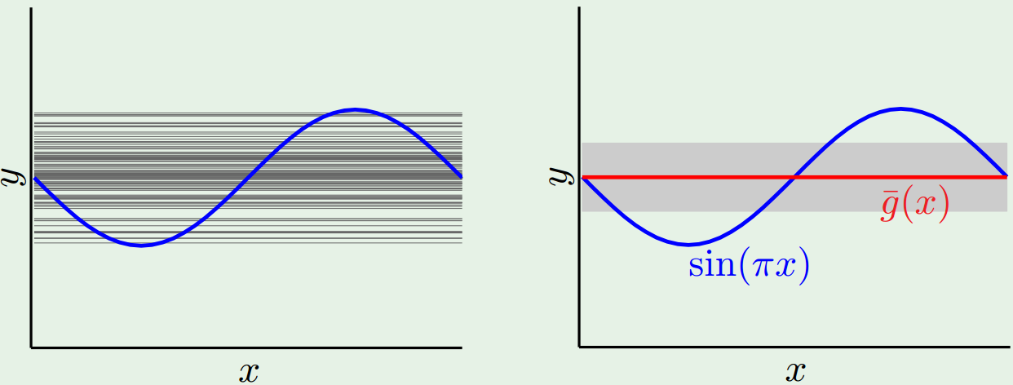



Average Variance $ℋ0$
$$Average Variance ℋ0=0.25$$
$$Error=Variance+Bias$$

Slide 21
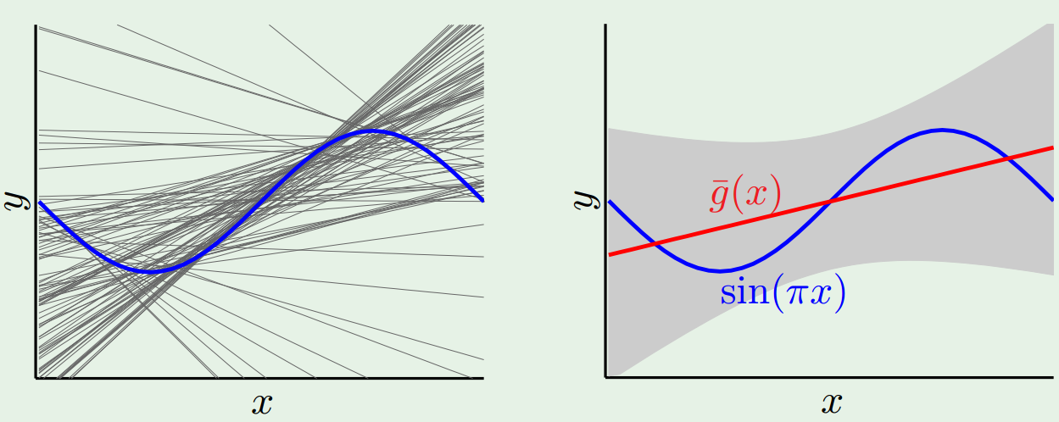


Average Variance $ℋ1$
$Average Variance ℋ1=1$.69
$$Error=Variance+Bias$$

Slide 22
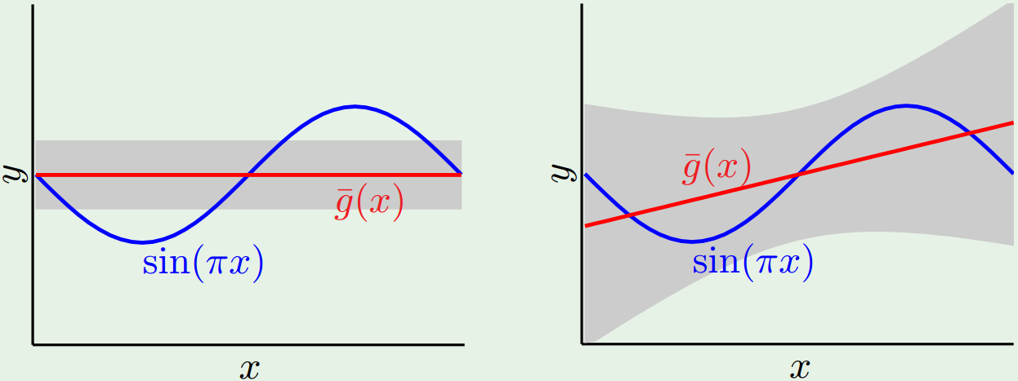


Total Average Error = Average Bias +Average Variance
$$𝓗1$$
$$𝓗0$$
Bias=0.50, variance=0.25
Bias=0.21, variance=1.69
Error = Bias+variance=0.50+0.25=0.75
Error = Bias+variance=0.21+1.69=1.90
With only 2 data points available for training, the simple model$𝓗0$is, on average, better!!!

Slide 23
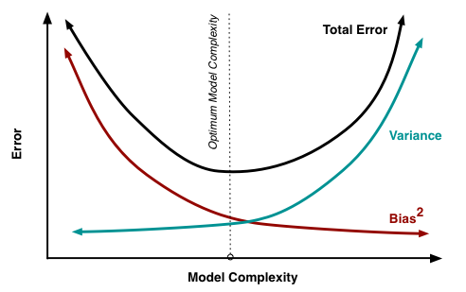
To sum up
A model ideal complexity (number of parameters) to maximize its accuracy is located at the optimal trade-off between model variance and model bias

Slide 24
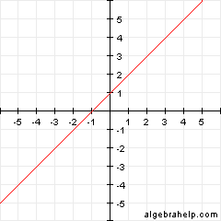
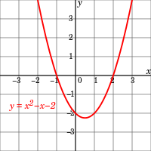
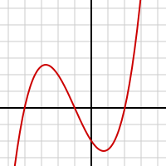
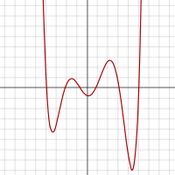




Polynomial Order or degree of a Polynomial
$$y=x+1$$
$$y=x2−x−2$$
$$y=\frac{x3}{4}+\frac{3x2}{4}−\frac{3x}{2}−2$$
$$y=\frac{1}{100}(x6−2x5−26x4+28x3+145x2−26x−80)$$
Higher order polynomials generate more complex/flexible/expressive models $hθ(x)$

Slide 25

Less complex/flexible models
More bias, Less variance
$ℋ0:hθ\left(x\right)=θ0$
$ℋ1:hθ\left(x\right)=θ0+θ1x$
$ℋ2:hθ\left(x\right)=θ0+θ1x+θ2x2$
$ℋ3:hθ\left(x\right)=θ0+θ1x+θ2x2+θ3x3$
Polynomial degree/model complexity
More complex/flexible models
Less bias, More variance

Slide 26
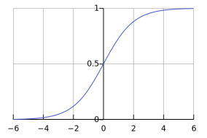
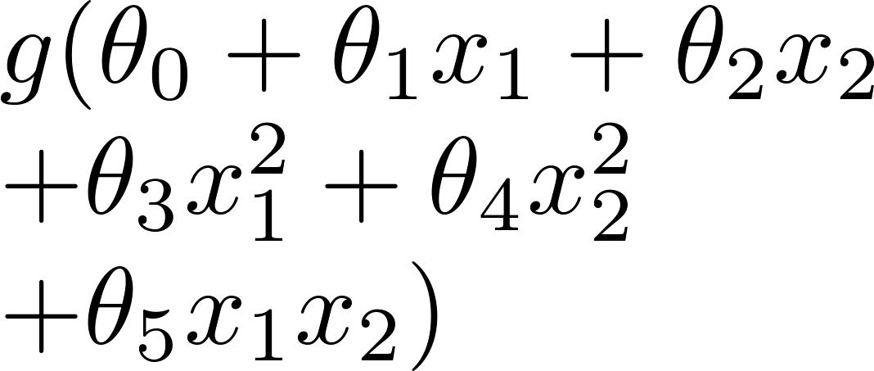
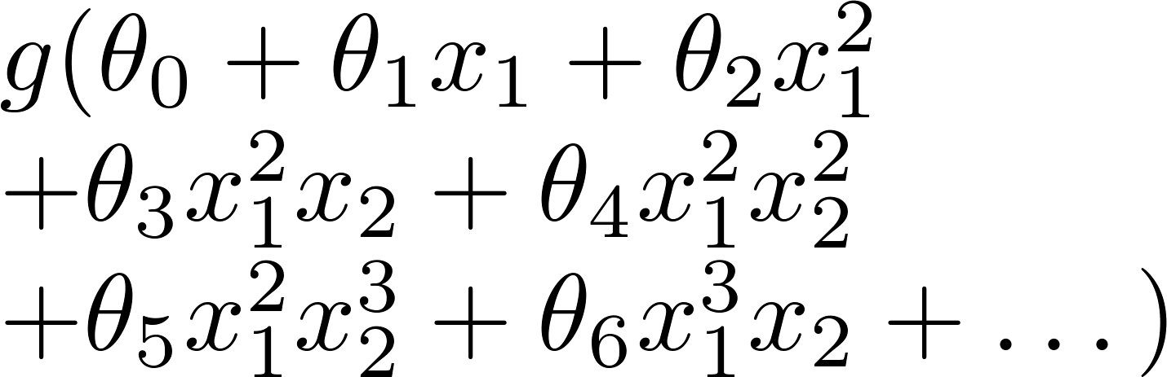

$$g\left(z\right)=\frac{1}{1+e^{−z}}$$
Bias and Variance in classification problems(Logistic regression)
x₂
x₂
x₂
x₁
x₁
x₁
$g=$sigmoid function)
Just right
(Optimal bias/variance
i.e. Optimal fitting)
Underfitting
(High bias, low variance)
Overfitting
(High variance, low bias)

Slide 27
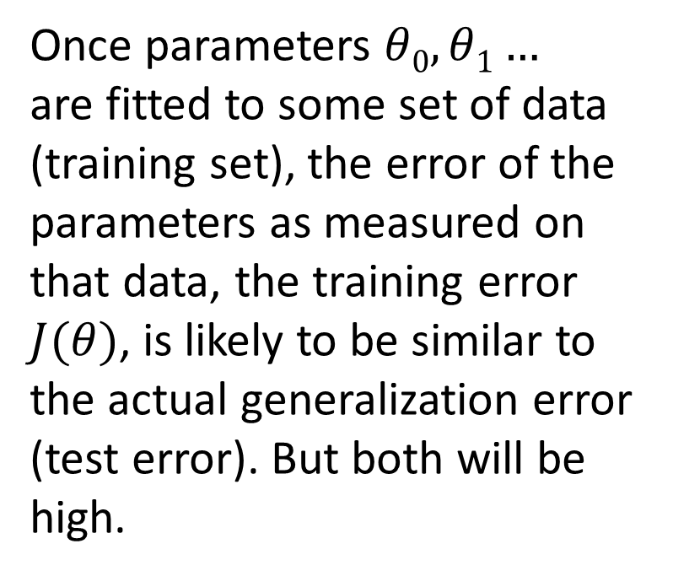

Underfitting (low variance, high bias) example
Once parameters $θ0,θ1…$
are fitted to some set of data (training set), the error of the parameters as measured on that data, the training error $J(θ)$, is likely to be similar to the actual generalization error (test error). But both will be high.
price
size
$$hθ\left(x\right)=θ0$$
The generalization error of a model is a measure of how well a learned model generalizes to unseen data

Slide 28
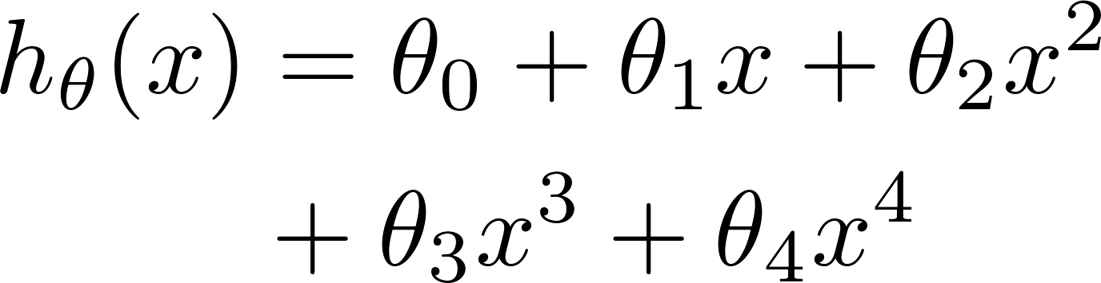
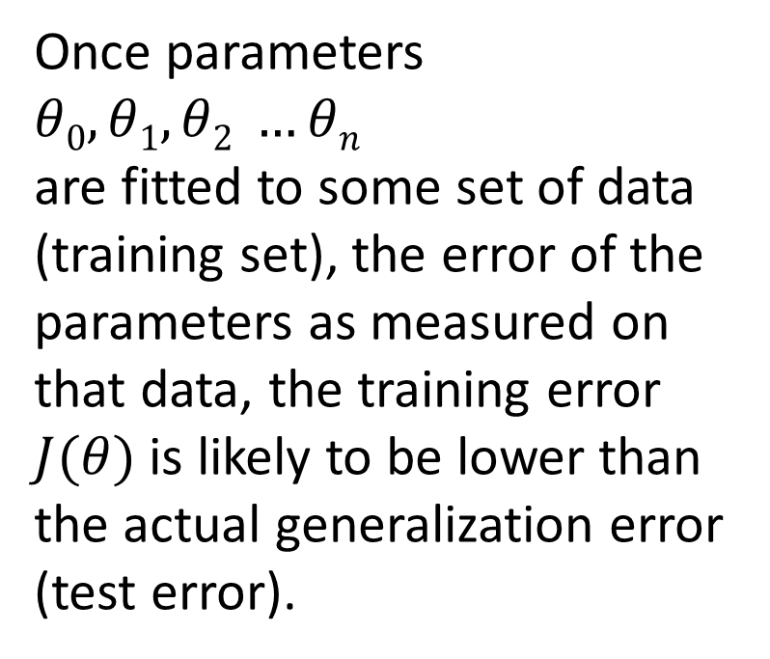
Overfitting (low bias, high variance) example
Once parameters $θ0,θ1,θ2 …θn$
are fitted to some set of data (training set), the error of the parameters as measured on that data, the training error $J(θ)$ is likely to be lower than the actual generalization error (test error).
price
size
The generalization error of a model is a measure of how well a learned model generalizes to unseen data

Slide 29


Increasing the complexity of the model improves performance on training data
$$y=θ0+θ1x$$
$$J(θ)$$
Price
Size of the house
Model Complexity/Flexibility

Slide 30

Increasing the complexity of the model improves performance on training data
$$y=θ0+θ1x+θ2x^{2}$$
$$J(θ)$$
Price
Size of the house
Model Complexity/Flexibility

Slide 31
Increasing the complexity of the model improves performance on training data
$$y=θ0+θ1x+θ2x^{2}+θx^{3}$$
$$J(θ)$$
Price
Size of the house
Model Complexity/Flexibility

Slide 32

Increasing the complexity of the model improves performance on training data
$$y=θ0+θ1x+θ2x2+θ3x3+θ4\sqrt{x}$$
$$J(θ)$$
Price
Size of the house
Model Complexity/Flexibility

Slide 33
Increasing the complexity of the model improves performance on training data
$$y=θ0+θ1x+θ2x2+θ3x3+…+θnxn$$
$$J(θ)$$
Price
Size of the house
Model Complexity/Flexibility

Slide 34
However, Increasing the complexity of the model only improves performance on test data (generalization ability) up to a certain point
$$y=θ0+θ1x+θ2x2+θ3x3+…+θnxn$$
$$J(θ)$$
Price
Size of the house
Model Complexity/Flexibility

Slide 35

However, Increasing the complexity of the model only improves performance on test data (generalization ability) up to a certain point
$$y=θ0+θ1x$$
model with 2° of freedom: $θ0, θ1$
$$J(θ)$$
Price
Size of the house
Model Complexity/Flexibility

Slide 36

However, Increasing the complexity of the model only improves performance on test data (generalization ability) up to a certain point
$$y=θ0+θ1x+θ2x^{2}$$
model with 3° of freedom: $θ0, θ1, θ$₂
$$J(θ)$$
Price
Size of the house
Model Complexity/Flexibility

Slide 37

However, Increasing the complexity of the model only improves performance on test data (generalization ability) up to a certain point
$$y=θ0+θ1x+θ2x^{2}+θ_{3}x^{3}$$
model with 4° of freedom: $θ0, θ1, θ$₂,$θ$₃
$$J(θ)$$
Price
Size of the house
Model Complexity/Flexibility

Slide 38

However, Increasing the complexity of the model only improves performance on test data (generalization ability) up to a certain point
$$y=θ0+θ1x+θ2x2+θ3x3+θ4\sqrt{x}$$
model with 5° of freedom: $θ0, θ1, θ$₂,$θ$₃, $θ$₄
$$J(θ)$$
Price
Size of the house
Model Complexity/Flexibility

Slide 39

However, Increasing the complexity of the model only improves performance on test data (generalization ability) up to a certain point
$$y=θ0+θ1x+θ2x2+θ3x3+…+θnxn$$
model with n° of freedom: $θ0, θ1, …θn$
$$J(θ)$$
Price
Size of the house
Model Complexity/Flexibility

Slide 40
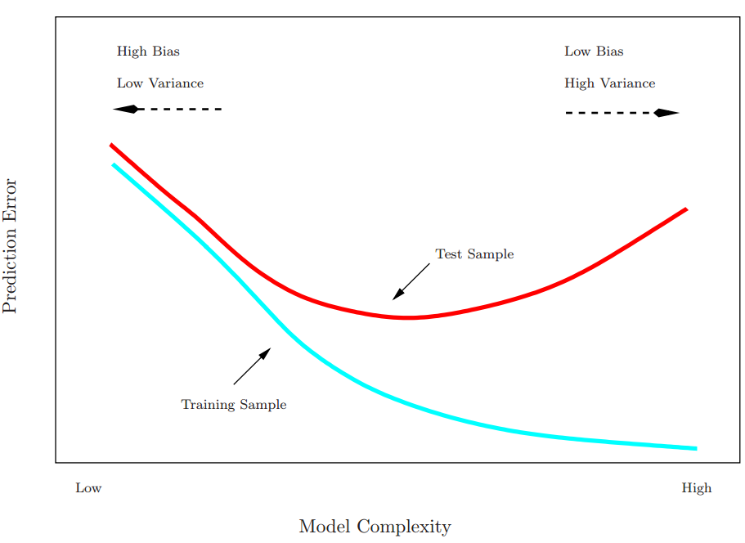
Overfitting implies bad generalization
$$Etest$$
Amount of overfitting for given model complexity
$$Etrain$$
Overfitting=E_{train} low, E_{test} high

Slide 41
Using learning curves to visualize the Error rate as a function of number of Training Points, N
E_{test}
E_{test}
Expected Error
E_{train}
Expected Error
E_{train}
Number of Training Points, N
Number of Training Points, N
Simple Model
Complex Model
Notice how as the number of data points, N, increases, overfitting (i.e. high variance) decreases
Therefore, match your model complexity to the amount of training points in your feature matrix X, not to the target function complexity

Slide 42
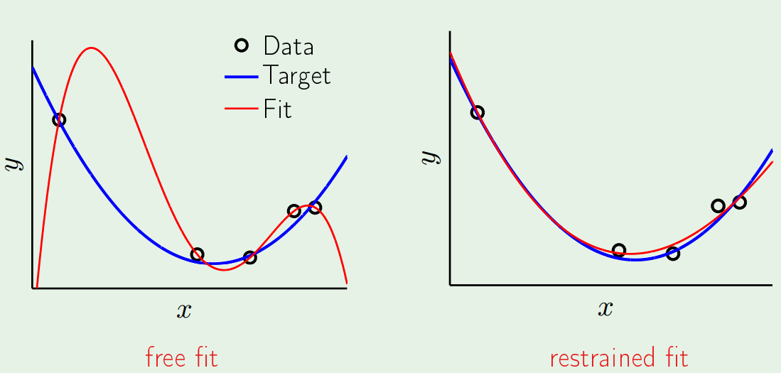
How to tackle overfitting?
In an ideal world, simply use more training data
But this is often not possible
use a simpler model (less parameters→less variance)
But those models tend to suffer from high bias
They are not complex/expressive enough to fit the data
An alternative, is to use regularization
A technique that still allows the model to explore complex shapes but with constraints imposed so it doesn’t derail into overfitting
Red curve is a 4th order polynomial
Red curve is a 4th order polynomial with regularization

Slide 43
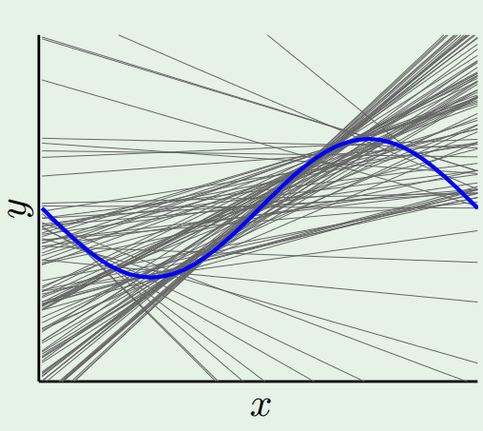
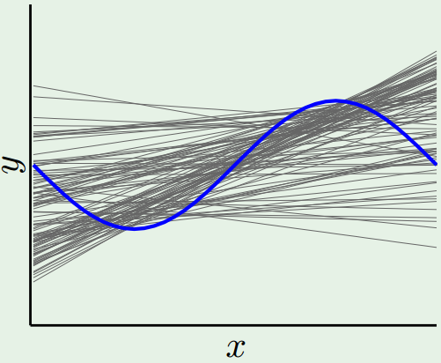


Regularization Intuition
$$y=b$$
$$y=θ0+θ1x$$
$$y=θ0+θ1x$$
complex model without regularization→ low bias but high variance
complex model with regularization→ low bias and low variance
Simpler model→ high bias

Slide 44






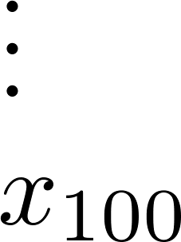

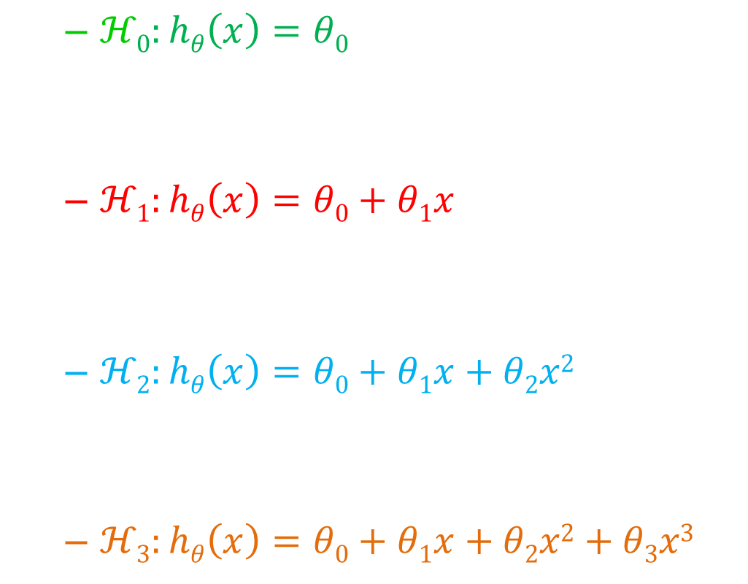
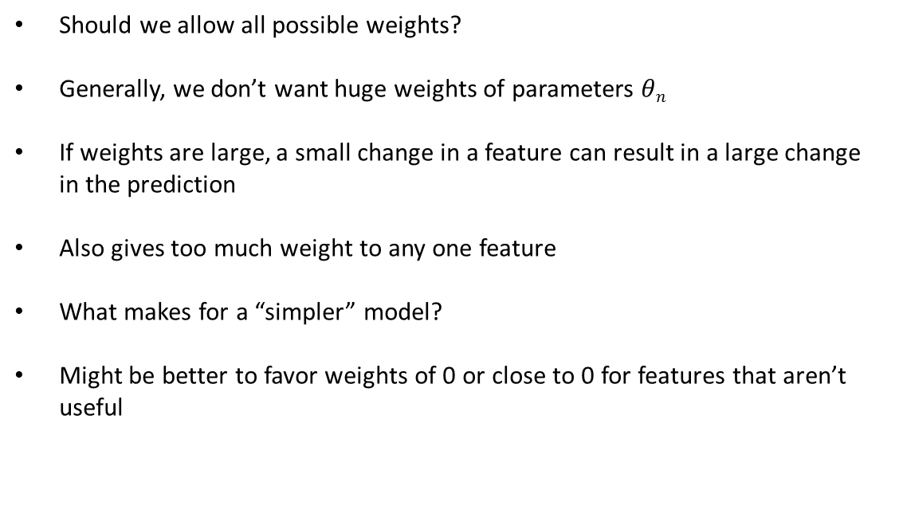
Regularization
size of house
Should we allow all possible weights?
Generally, we don’t want huge weights of parameters $θn$
If weights are large, a small change in a feature can result in a large change in the prediction
Also gives too much weight to any one feature
What makes for a “simpler” model?
Might be better to favor weights of 0 or close to 0 for features that aren’t useful
no. of bedrooms
age of house
Mean neighborhood income
number of floors
kitchen size
$=$ age of house
$$hθ\left(x\right)=θ0+\sum_{j=1}^{100}{θjxj=θ0+θ1x1+θ2x2+θ3x3+…+θ100x100}$$

Slide 45


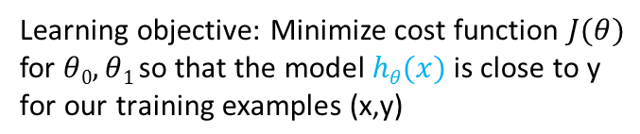
Remember linear regression?
y
$$hθ(x)=θ0+θ1x$$
Learning objective: Minimize cost function $J(θ)$ for $θ0,θ1 \text{s}\text{o} \text{tha}\text{t} \text{the} \text{model} hθ(x) \text{is} \text{close} \text{to} \text{y} \text{for} \text{our} \text{training} \text{examples} \text{(}\text{x}\text{,}\text{y}\text{)}$
x
$$J(θ)=\frac{1}{2m}\left[\sum_{i=1}^{m}{{\left(hθ\left(x^{\left(i\right)}\right)−y^{\left(i\right)}\right)}^{2}}\right]$$

Slide 46
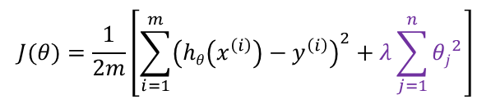
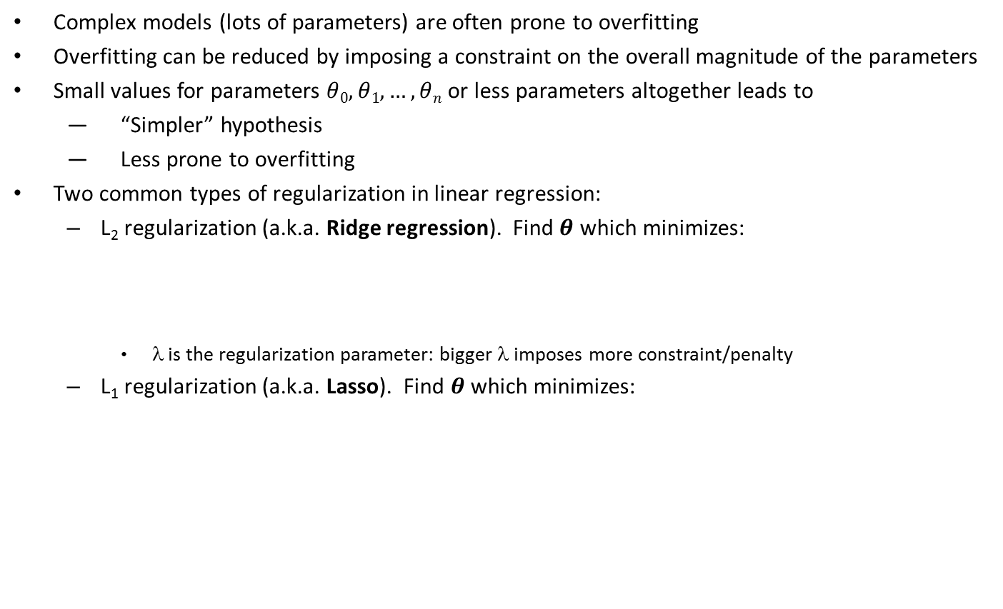
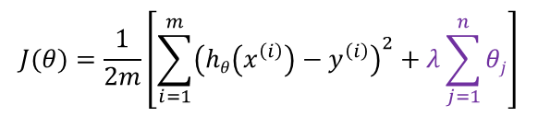
Regularization
Complex models (lots of parameters) are often prone to overfitting
Overfitting can be reduced by imposing a constraint on the overall magnitude of the parameters
Small values for parameters $θ0,θ1,…,θn$ or less parameters altogether leads to
“Simpler” hypothesis
Less prone to overfitting
Two common types of regularization in linear regression:
L₂ regularization (a.k.a. Ridge regression). Find $θ$ which minimizes:
λ is the regularization parameter: bigger λ imposes more constraint/penalty
L₁ regularization (a.k.a. Lasso). Find $θ$ which minimizes:
$$J(θ)=\frac{1}{2m}\left[\sum_{i=1}^{m}{{\left(hθ\left(x^{\left(i\right)}\right)−y^{\left(i\right)}\right)}^{2}+λ\sum_{j=1}^{n}{{θj}^{2}}}\right]$$
$$J(θ)=\frac{1}{2m}\left[\sum_{i=1}^{m}{{\left(hθ\left(x^{\left(i\right)}\right)−y^{\left(i\right)}\right)}^{2}+λ\sum_{j=1}^{n}{θj}}\right]$$

Slide 47
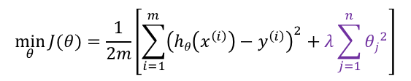
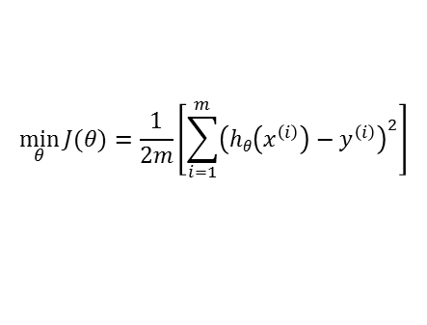
Model with no Regularization
Model with Regularization
$$\min_{θ}{J(θ)=\frac{1}{2m}\left[\sum_{i=1}^{m}{{\left(hθ\left(x^{\left(i\right)}\right)−y^{\left(i\right)}\right)}^{2}}\right]}$$
$$\min_{θ}{J(θ)=\frac{1}{2m}\left[\sum_{i=1}^{m}{{\left(hθ\left(x^{\left(i\right)}\right)−y^{\left(i\right)}\right)}^{2}+λ\sum_{j=1}^{n}{{θj}^{2}}}\right]}$$
Price
Price
Size
Size

Slide 48
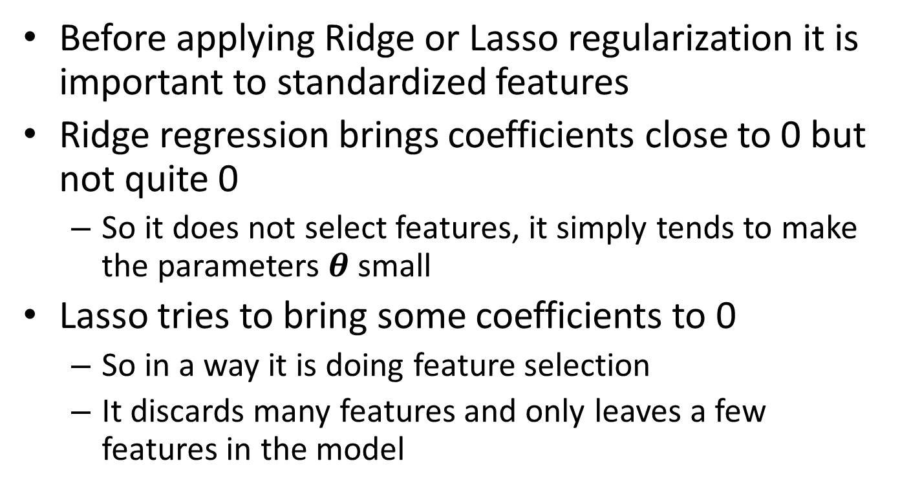
Technical comments
Before applying Ridge or Lasso regularization it is important to standardized features
Ridge regression brings coefficients close to 0 but not quite 0
So it does not select features, it simply tends to make the parameters $θ$ small
Lasso tries to bring some coefficients to 0
So in a way it is doing feature selection
It discards many features and only leaves a few features in the model

Slide 49

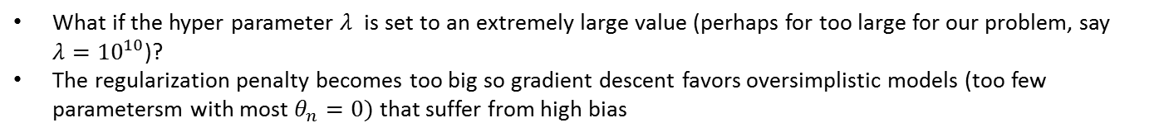

In regularized linear regression, we choose $θ$ to minimize
$$\min_{θ}{J(θ)=\frac{1}{2m}\left[\sum_{i=1}^{m}{{\left(hθ\left(x^{\left(i\right)}\right)−y^{\left(i\right)}\right)}^{2}+λ\sum_{j=1}^{n}{θj}}\right]}$$
What if the hyper parameter $λ$ is set to an extremely large value (perhaps for too large for our problem, say $λ={10}^{10}$)?
The regularization penalty becomes too big so gradient descent favors oversimplistic models (too few parametersm with most $θ_{n}=0)$ that suffer from high bias
$$θ1≈0$$
$$θ2≈0$$
$$θ3≈0$$
$$⋮$$
$$θn≈0$$
Price
Size
$$hθ\left(x\right)=θ0+θ1x+θ2x2+θ3x3+…+θnxn$$

Slide 50



Choosing the right type parameter $λ$in regularization is an example of hyper parameter tuning
complex model: polynomial order 4
$$\min_{θ}{J(θ)=\frac{1}{2m}\left[\sum_{i=1}^{m}{{\left(hθ\left(x^{\left(i\right)}\right)−y^{\left(i\right)}\right)}^{2}+λ\sum_{j=1}^{4}{θj}}\right]}$$
$$y=f\left(x\right)≈θ0+θ1x4+θ2x3+θ3x2+θ4x$$
Overfitting
(high variance)
Underfitting
(high bias)

Slide 51




Regularization also applies to other machine learning algorithms not only linear regression. For instance, here I illustrate logistic regression
x₂
x₁
Cost function for logistic regression with regularization penalty:
$$+\frac{λ}{2m}\sum_{j=1}^{n}{{θj}^{2}}$$

Slide 52

Take home message
You can control the complexity of your model $hθ(x)$ via regularization
Ridge regression regularization performs better when the true target function is a function of a lot predictors
Lasso regression regularization performs better when the true target function is a function of only a few predictors
The number of predictors in our target function is usually not known a priori for real data sets
You receive a feature matrix X with hundreds of columns ( features/predictors), and you don’t know which columns are truly relevant in predicting y
A technique we will learn in the future, cross validation, can help us choose the right model for a given training data set X

Slide 53



Is increasing the number of features in your feature matrix $X$ always a good idea?
Example of a bank trying to predict if a customer will default on a loan
$$X$$
?
$$y$$

Slide 54


The Problem: The curse of dimensionality
As the dimensionality of $X$ increases, the classifier’s performance increases until the optimal number of features is reached. Further increasing the dimensionality without increasing the number of training samples results in a decrease in classifier performance. This is due to the curse of dimensionality
The curse of dimensionality refers to various phenomena that arise when analyzing and organizing data in high-dimensional spaces (often with hundreds or thousands of dimensions) that do not occur in low-dimensional settings such as the 2D or 3D dimensional physical space of everyday experience
The common theme of these problems is that when the dimensionality increases, the volume of the space increases so fast that the available data becomes sparse.
This scarcity is problematic. In order to obtain a statistically sound and reliable result, the amount of data needed to support the result often grows exponentially with the dimensionality.
Organizing and searching data often relies on detecting areas where objects form groups with similar properties; in high dimensional data however all objects appear to be sparse and dissimilar from each other in many ways which prevents common data organization strategies from being efficient.

Slide 55

The curse of dimensionality… why?
If you have a fixed number of training instances, as you increase the dimensionality of the feature space, the space becomes exponentially sparse. That is, there is very little data in a unit of volume of the space

Slide 56

The curse of dimensionality
Using too many features and sparsity results in overfitting
The model performs very well on the training data
But poorly on the test data
The classifier learns exceptions that are specific to the training data and do not generalize well when new data is encountered
Another effect of the curse of dimensionality, is that sparseness is not uniformly distributed over the search space
Data around the origin (at the center of the hypercube) is much more sparse than data in the corners of the search space
As the dimensionality increases, a larger percentage of the training data resides in the corners of the features space
Distance measures start losing their effectiveness to measure dissimilarity in highly dimensional spaces
Each data point looks far away/dissimilar from every other point.
Since classifiers depend on these distance measures (e.g. Euclidean distance, Mahalanobis distance, Manhattan distance), classification is often easier in lower-dimensional spaces where less features are used to describe the object of interest.
How to avoid the curse of dimensionality?
The smaller the size of the training data, the less features that should be used
The number of training instances needed grows exponentially with the number of dimensions used

Slide 57
Visualization on how increasing the number of features leads to sparcity in the feature space
All students and staff at Otago Polytechnic
Let’s place in a big room all the people who study or work at Otago Polytechnic
Number of rooms required to accommodate everyone (the data set): 1

Slide 58

$$X$$
Visualization on how increasing the number of features leads to sparcity in the feature space
students
Let’s place in a big room all the people who study or work at Otago Polytechnic
Feature 1: Students or staff
Number of rooms required to accommodate everyone (the data set): 2

Slide 59
$$X$$
Visualization on how increasing the number of features leads to sparcity in the feature space
Students,male
Let’s place in a big room all the people who study or work at Otago Polytechnic
Feature 1: Students or staff
Feature 2: gender (male or female)
Number of rooms required to accommodate everyone (the data set): 4

Slide 60
$$X$$
Visualization on how increasing the number of features leads to sparcity in the feature space
Students,male,young
Let’s place in a big room all the people who study or work at Otago Polytechnic
Feature 1: Students or staff
Feature 2: gender (male or female)
Feature 3: age bracket (young <30,old >30)
Number of rooms required to accommodate everyone (the data set): 8

Slide 61
$$X$$
Visualization on how increasing the number of features leads to sparcity in the feature space
Students,male,young,Dunedin born,
Let’s place in a big room all the people who study or work at Otago Polytechnic
Feature 1: Students or staff
Feature 2: gender (male or female)
Feature 3: age bracket (young <30,old >30)
Feature 4: Dunedin born (yes/no)
Number of rooms required to accommodate everyone (the data set): 16

Slide 62
$$X$$
Visualization on how increasing the number of features leads to sparcity in the feature space
Students,male,young,Dunedin born,not married
Let’s place in a big room all the people who study or work at Otago Polytechnic
Feature 1: Students or staff
Feature 2: gender (male or female) Feature 3: age bracket (young <30,old >30)
Feature 4: Dunedin born (yes/no)
Feature 5: Married (yes/no)
Number of rooms required to accommodate everyone (the data set): 32

Slide 63
$$X$$
Visualization on how increasing the number of features leads to sparcity in the feature space
Students,male,young,Dunedin born,not married,
blonde
Let’s place in a big room all the people who study or work at Otago Polytechnic
Feature 1: Students or staff
Feature 2: gender (male or female)
Feature 3: age bracket (young <30,old >30)
Feature 4: Dunedin born (yes/no)
Feature 5: Married (yes/no)
Feature 6: Blond (yes/no)
Number of rooms required to accommodate everyone (the data set): 64

Slide 64
$$X$$
Visualization on how increasing the number of features leads to sparcity in the feature space
Students,male,young,Dunedin born,not married,
Blonde, lives in Opoho
Let’s place in a big room all the people who study or work at Otago Polytechnic
Feature 1: Students or staff
Feature 2: gender (male or female) Feature 3: age bracket (young <30,old >30)
Feature 4: Dunedin born (yes/no)
Feature 5: Married (yes/no)
Feature 6: Blond (yes/no)
Feature 7: lives in Opoho (yes/no)
Number of rooms required to accommodate everyone (the data set): 128

